Slide 1

Summer Academy STEM Majors
By Dwayne Clarke

Slide 2
Ice Breaker
What your name?
What is your favorite theme park?
Fun fact about yourself?

Slide 3
LIST OF CONTENTS
01
03
05
ABOUT ME
BENEFITS OF TERM
CONTACT
02
04
MY JOURNEY
MY PROJECTS

Slide 4



Introducing
ABOUT ME
Dwayne Clarke
Computer Scientist at NAVAIR

Slide 5

MY JOURNEY
High School
College
Career

Slide 6
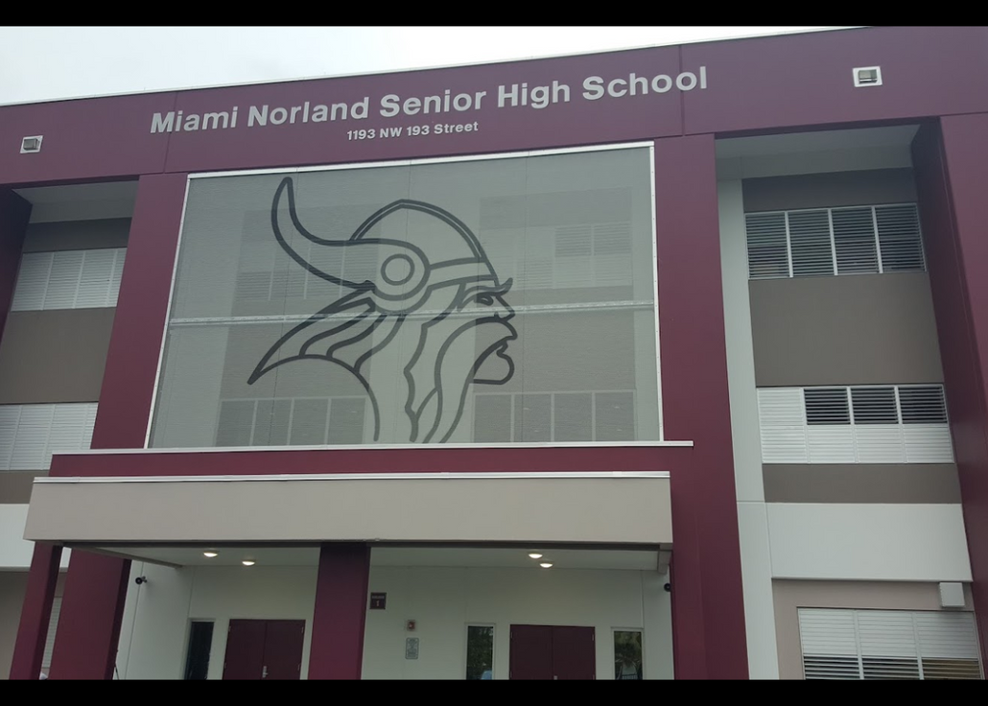
High School
01
Graduate with 2.3 GPA
02
Fail Standard Test 3 Times
03
Didn't know what I wanted to do

Slide 7
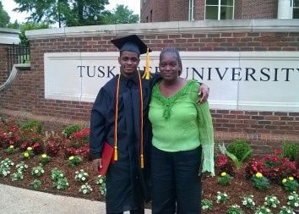
College
01
Full Ride Scholarship from Miami Dade College to Tuskegee University for Undergrad Degree
02
Graduate with Honors
03
Grant for SMART Scholarship for my Master Degree
04
Build Android Applications
05
Graduation Debt Free

Slide 8
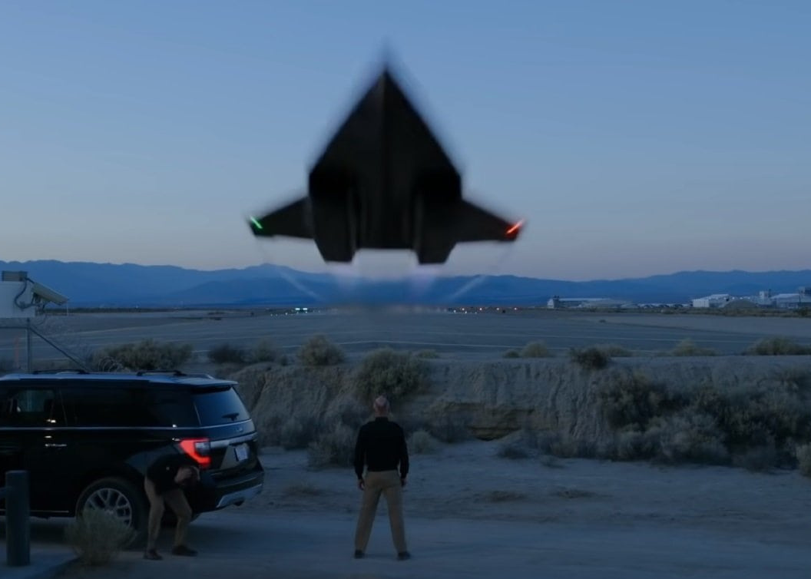
Career
01
Join NAVAIR 2017
02
Graduation Engineer & Scientist Development Program
03
Working with Automate

Slide 9

BENEFITS OF STEM MAJORS
Impact the World
High salaries
Job Satisfaction
Growing Career Field

Slide 10

Impact the World
Building your legacy
Work with latest and cutting edge technology
Constantly learn and build new skills
Building for the next generation

Slide 11

High salaries
Stem
Non-Stem
$100,000
$75,000
$50,000
$25,000
$0
Salaries
Notes:
STEM workers who majored in a STEM field in college typically made higher salaries than those who did not: on average, $101,100 vs. $87,600.
According to the American Engineering Association, STEM graduates earn about 87% more than non-STEM graduates.
Even STEM majors who eventually work in non-STEM occupations earn more than their counterparts who do not hold STEM degrees.

Slide 12
Job Satisfaction
80%
8 out of 10 Stem Majors
70%
7 out of 10 Non-Stem Majors

Slide 13
Growing Career Field
Stem
Non-Stem
0%
2%
4%
6%
8%

Slide 14


Project 01 - Building Computer
Project
Project 02 - Building Ebike
PORTFOLIO
Project 03 - Website Development
Project 04 - Editing Videos
Project 05 - RetroPie
Project 06 - Sense Hat

Slide 15
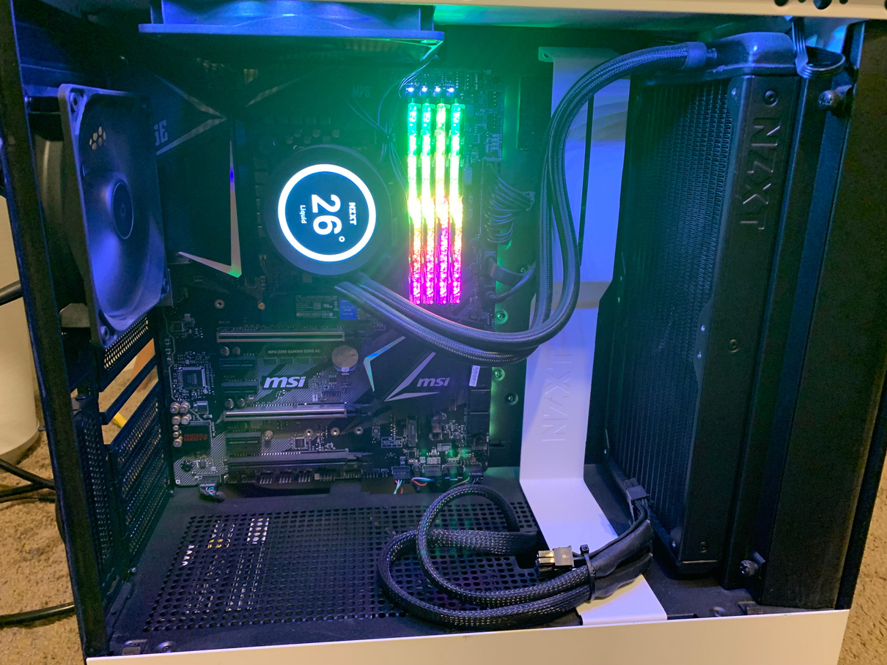
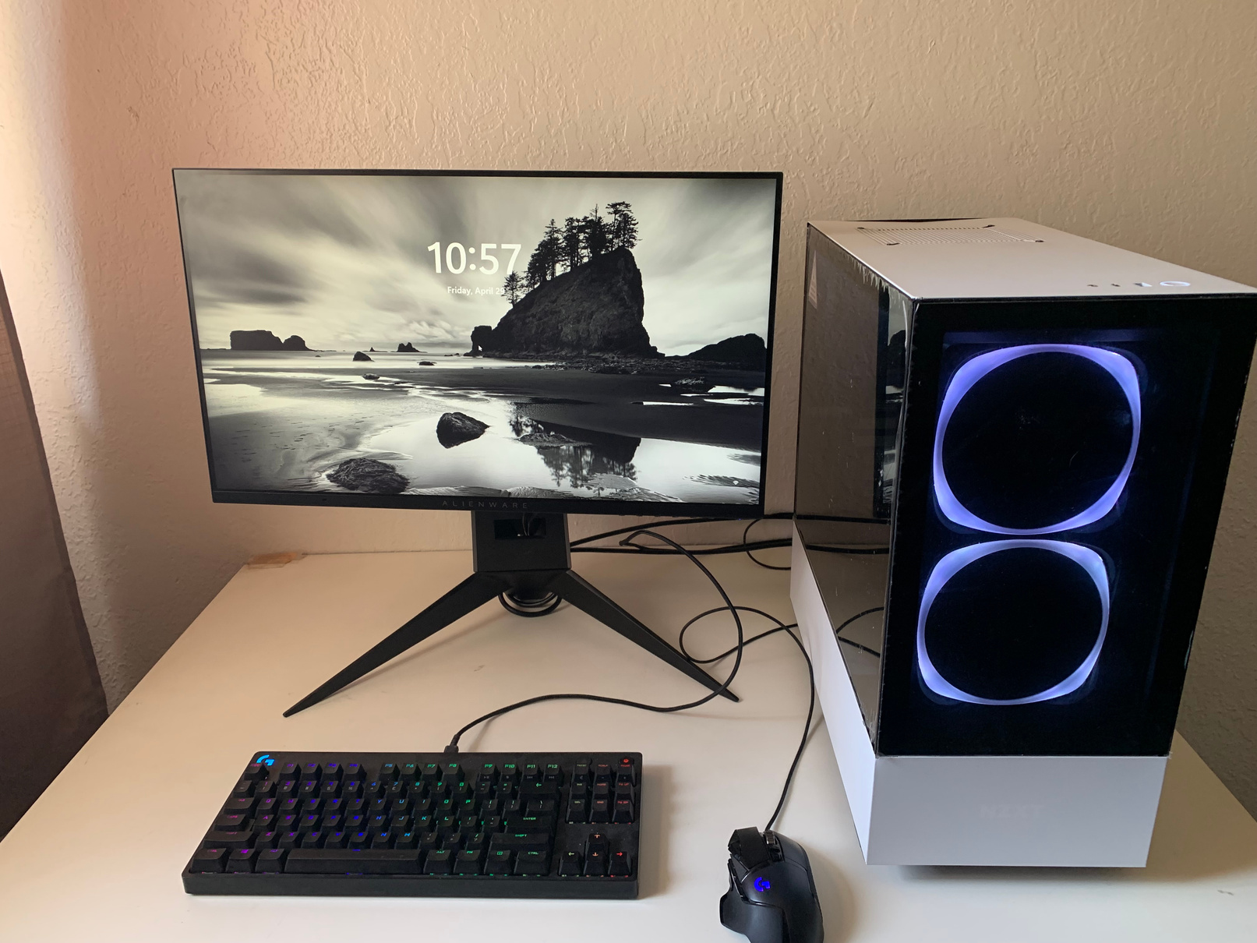
PROJECT 01 - BUILDING COMPUTER

Slide 16


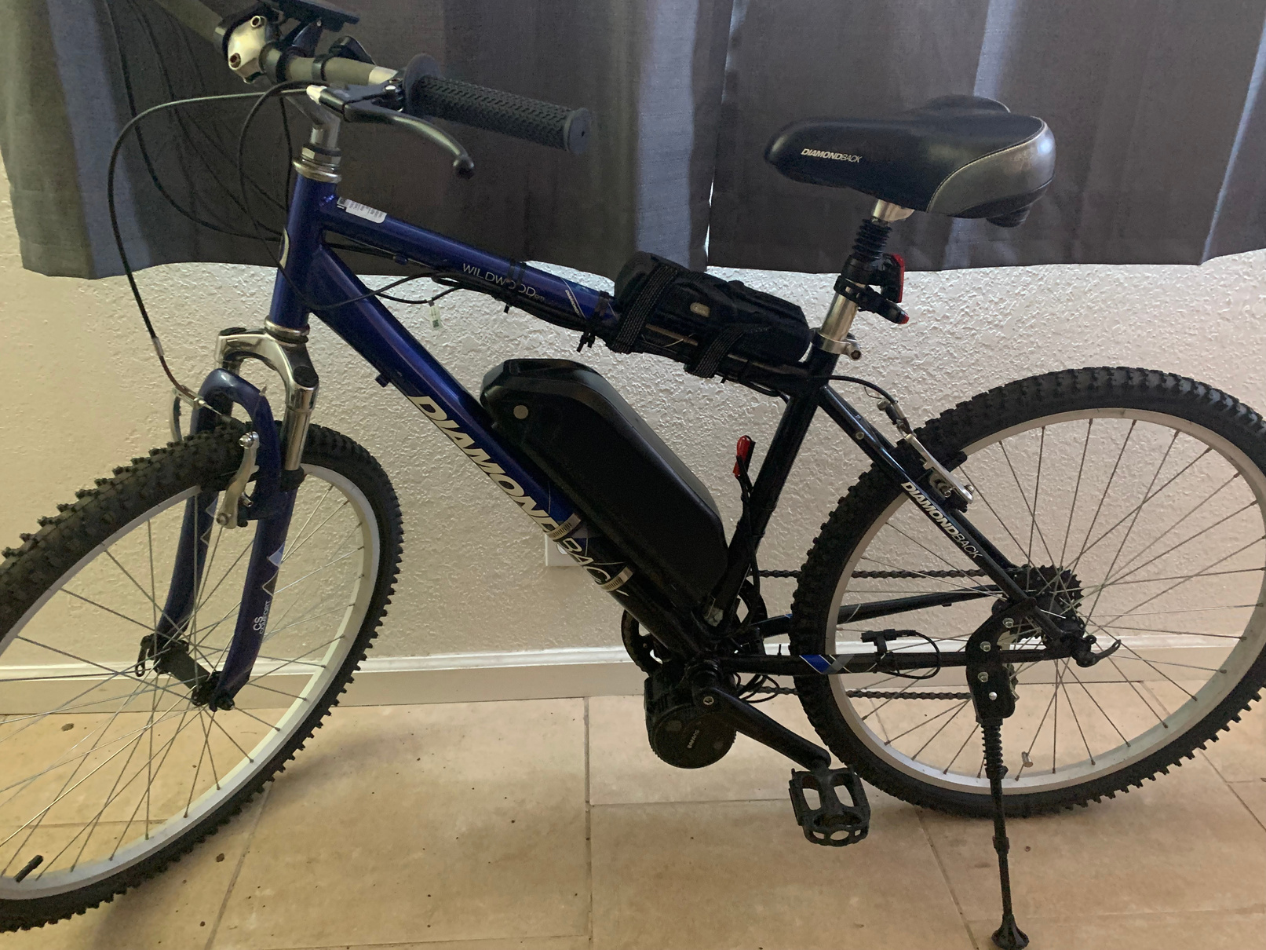
PROJECT 02 - BUILDING EBIKE
E-bikes use rechargeable batteries that can travel up to 25 to 45 km/h, much faster than most people would cycle, getting you to your destination quicker and in better shape. In a nutshell they offer low cost, energy efficient, and emission-free transportation which also has physical and health benefits.

Slide 17



PROJECT 03 - WEB DEVELOPMENT
https://dividendmind.com/
https://dwaynedca.wordpress.com/

Slide 18
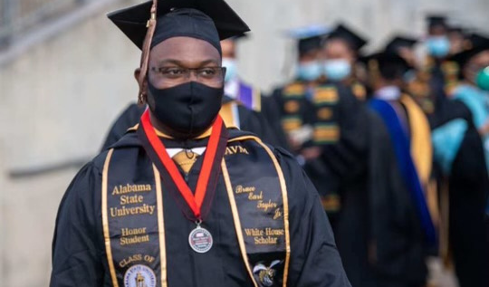
PROJECT 04 - EDITING VIDEOS
Interview from Dividend Mind Scholarship
https://www.youtube.com/watch?v=MDjt1BiZtKE

Slide 19
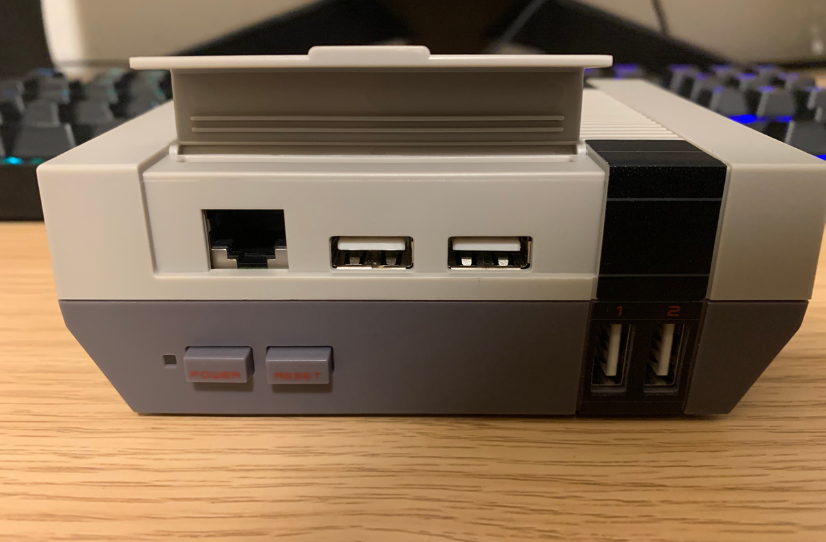

PROJECT
05 - RETROPIE
RetroPie enable you to play your favorite
Arcade, home-console, and classic
PC games with the minimum set-up.

Slide 20
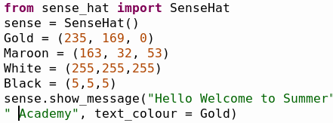
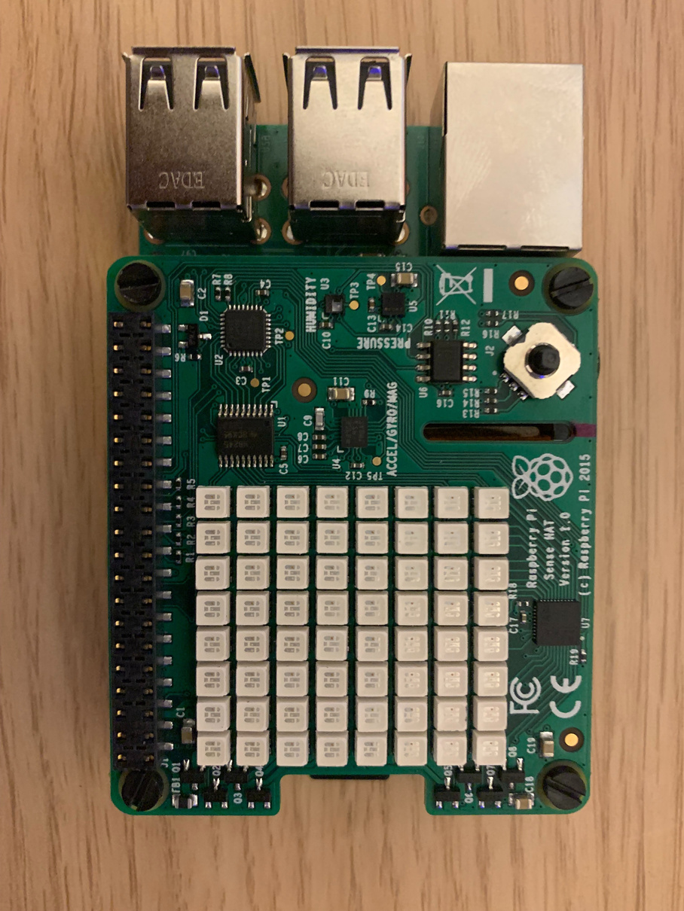
PROJECT 06 - SENSEHAT
The Sense HAT is an add-on board for the Raspberry Pi, made especially for the Astro Pi competition. The board allows you to make measurements of temperature, humidity, pressure, and orientation, and to output information using its built-in LED matrix.

Slide 21




THANK YOU
CONTACT ME
3057857086
dwaynedca@protonmail.com
www.dividendmind.com

